Slide 1


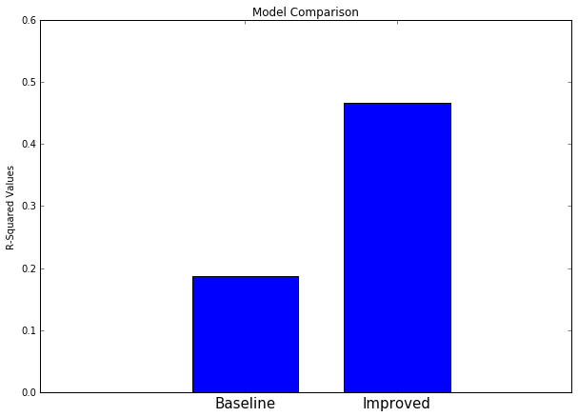

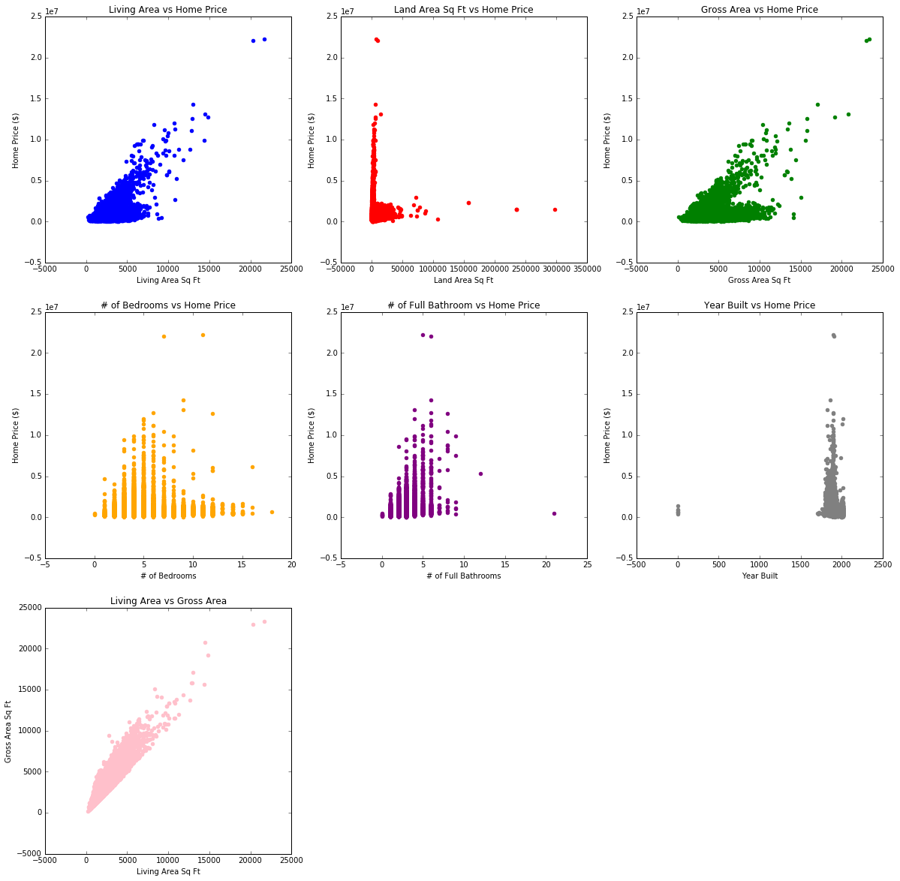
Sous Chef:
Design of a Cooking Application for the Visually Impaired
Tallulah Axinn, Jocelyn Fu, Vinay Iyengar, Emily Lovett
Harvard College
CS179 Final Project
The Problem
Our Designs
Results
285 million people worldwide suffer from some form of a visual impairment
Over 7 million reside in the United States, 2% of the population
Suffer from disproportionately high rates of unemployment and poverty
Visual impairments are not a disability – we live in a world designed for those with sight
Data Sourcing
The dataset comes from the City of Boston Assessing Department which is responsible for providing the current value and tax status of properties in the Boston area. It has 169199 observations and 77 features such as:
Land and living square footage
Number of rooms (bedrooms and bathrooms)
Building style
Year of latest remodel
City of Boston.Gov
Data Boston
Data Cleaning
Step 1: Remove all rows with home values of $0 because those were illogical.
Step 2: Perform one-hot encoding to modify qualitative features such as building style.
Step 3: Remove rows that were missing data for key factors such as living area and gross area.
Needfinding
Visually impaired have a lot of trouble with normal daily tasks, such as cooking
Want to cook for themselves, for pleasure and because it saves a lot of money
Have a lot of trouble navigating grocery stores, using kitchen tools
Apps like Blue Apron and Instacart are not accessible
Data Exploration
Figure 2: The improved model has a much higher R-squared of 0.44 compared to the baseline model with an R-squared of 0.18.
Optimal Model – Tuned Lasso Regression with parameter of 100
R-squared – 0.44
Final Features – living area, # bedrooms, # bathrooms, year built, style of home
Average Residuals – $200,456
Conclusions
Objectives
Model performs on par with best findings in literature such as Lowrance, 2015
Also support thesis that linear models (such as Ridge Regression) are superior to non-linear ones such decision trees, random forests, etc.
Final features selected reaffirm literature (use of interior size features), and also provide insight into new ones such as style of home
Presents a new computational method for real estate private equity firms to value residential properties in an accurate and efficient manner.
To design a mobile application to aid the visually impaired with grocery shopping and cooking
Empower the visually impaired by making them less reliant on others
Figure 1: The above plots show linear relationships for some features such as living area square footage and gross area square footage. The other relationships are not as clear.
Model Building
Baseline Model
Improved Models
Types
Built
Linear Regression
Ridge
Lasso
LDA and QDA
Random Forest
Decision Tree
References
Steven C. Bourassa, Eva Cantoni, and Martin Hoesli, Predicting house prices with spatial dependence: A comparison of alternative approaches, Journal of Real Estate Research 32 (2010), no. 2, 139–159.
Lowrance, Roy E and Dennis Shasha. “Predicting the Market Value of Single-family Residential Real Estate.” (2015).
Wu, Lynn and Brynjolfsson, Erik, The Future of Prediction: How Google Searches Foreshadow Housing Prices and Sales (August 30, 2013). Available at SSRN: https://ssrn.com/abstract=2022293 or http://dx.doi.org/10.2139/ssrn.2022293
Acknowledgements
Features
Uses all 77 features
Uses only 5 features
We’re grateful to our mentor, Siv Lu for her guidance on this project. In addition, we’d like to thank the instructors, Pavlos, Wei Wei, and Kevin for their support throughout the semester.
Notes:
The data set is for the 2016 fiscal year and is updated yearly to capture “new construction, damage, and changes in ownership of property in Boston.”
-
Implemented a variety of approaches:
LR,
Lasso,
Ridge,
Random Forest,
Tuned Lasso– 0.46
Residuals
Gross area, land SF,

